Slide 1
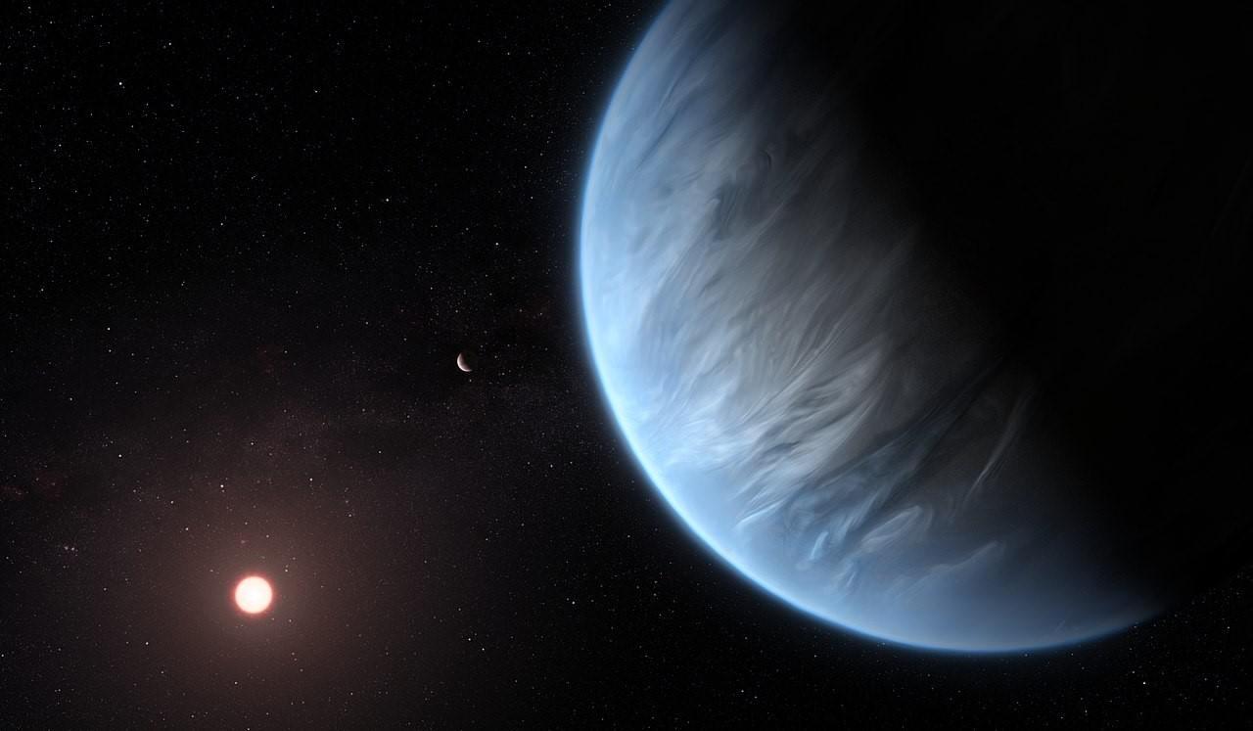

Differentiating Mini-Neptune and Terrestrial Atmospheres for HWO
${Elizabeth Pawelka}^{1,2}$
Mentors: ${Nick Wogan}^{1}$, ${Natasha Batalha}^{1}$
$${NASA Ames}^{1},{University of Washington}^{2}$$
Image Credit: ESA/Hubble, M. Kornmesser

Slide 2
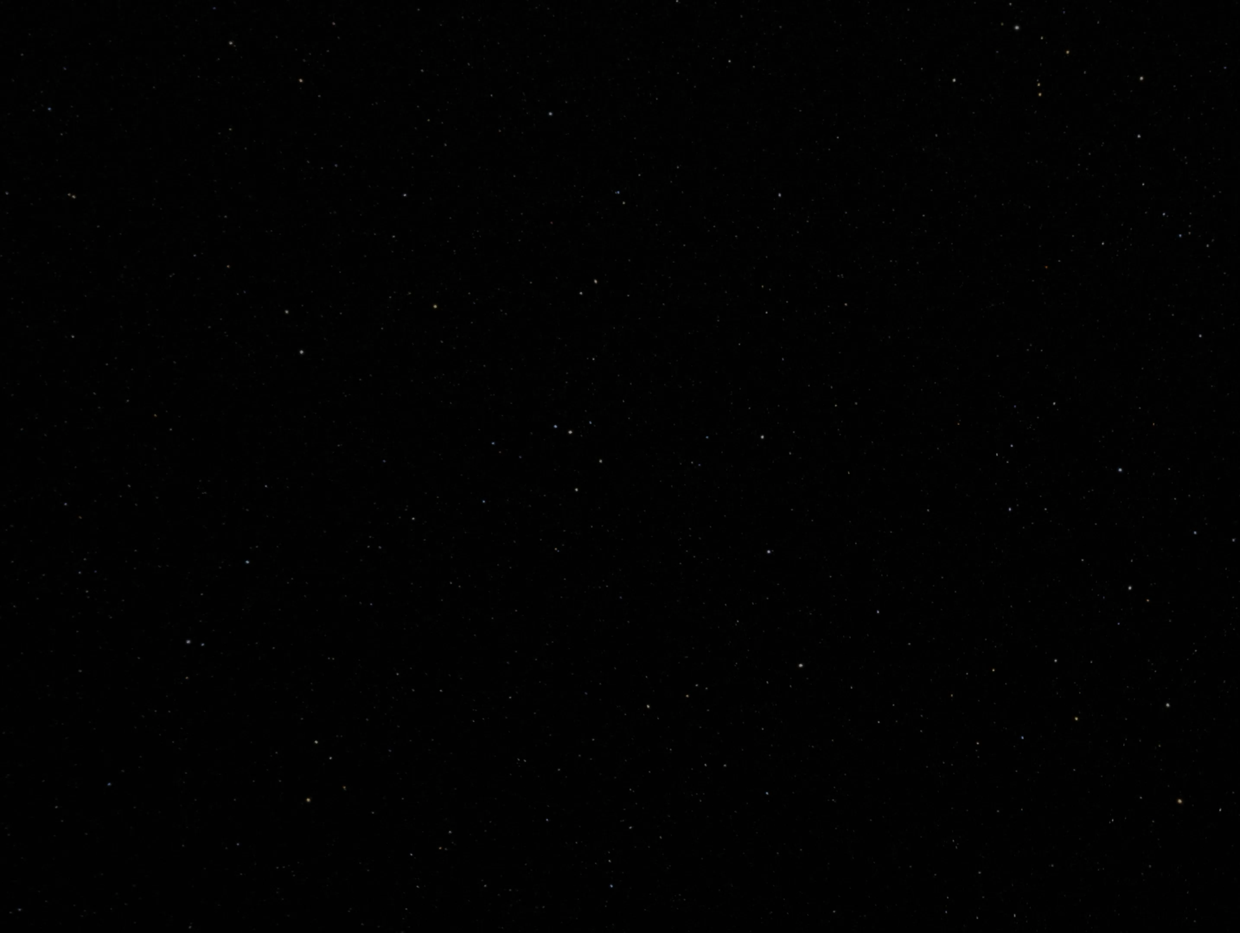
Motivation
The Habitable Worlds Observatory (HWO) aims to:
Detect and characterize Earth-like planets around Sun-like stars in search for biosignatures and potentially habitable conditions
Examine the spectra of reflected light; but the mass, radius, and bulk density are poorly constrained
Would we be seeing a large gas giant with lower albedo, or a smaller terrestrial world with higher albedo?

Slide 3
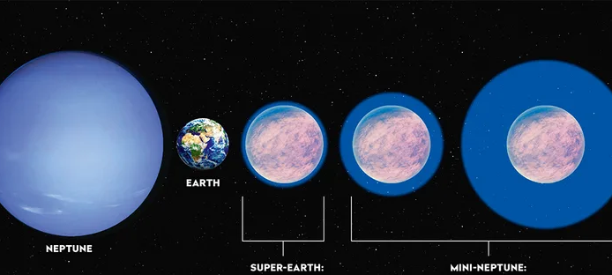
Major Question:
How can we differentiate the reflected spectra of uninhabited mini-Neptunes from Earth-like planets with HWO?
Image Credit: NASA/ESA?CSA and STScI

Slide 4
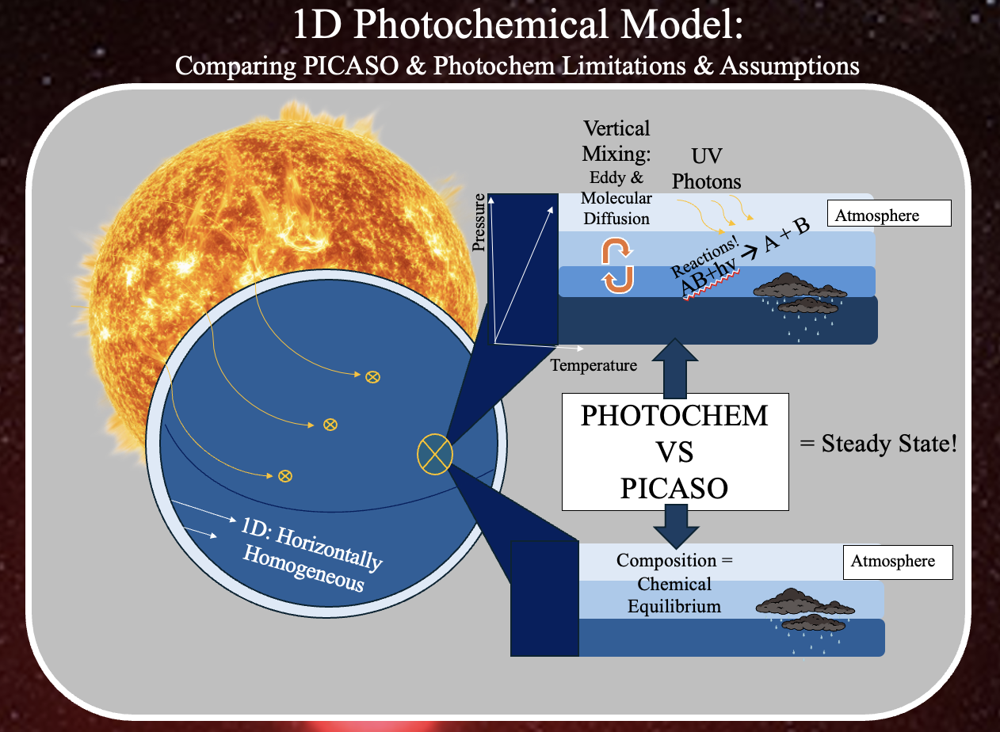
Quick Model Overview:
PICASO | PHOTOCHEM
Computes exoplanet/brown dwarf… Spectroscopy in transmission, emission, or reflected light 1D climate models Spectroscopic data fits to models I utilize… 1D climate modeling for gas giants (mini-Neptunes) which provides a pressure and temperature profile that accounts for convective layers in the atmosphere, assumes chemical equilibrium and energy conservation at every level. For more specifics see Mukherjee et. al. 2022. Reflected light spectra given a pressure-temperature profile and atmospheric composition calculated by Photochem to find fpfs (flux of planet to star, albedo of the cloud, and wavelength range) | Computes planet… Photochemical Model Climate Model I utilize… Photochemical model for gas giants to calculate steady state chemical using the PT profile from PICASO accounting for UV radiation and vertical mixing with a temperature gradient (more than just chemical equilibrium); assumes mass conservation.

Slide 5
Workflow & Assumptions:
Grid 1: PICASO_Climate_grid
Grid 2: Photochem_grid
Step 1: Apply PICASO model to solve for temperature as a function of pressure for 1D climate modeling.
Step 2: Take the PT profile from PICASO and solve for photochemistry of the atmosphere using Photochem (does extrapolate PT from PICASO and adjusts resolution)
Grid 3: Reflected_Spectra_grid
Step 3: Takes adjusted PT and Photochemical model and calculates reflected light spectrum using PICASO
Step 4: Loop through steps 1-3 changing known inputs for a grid of gas planet and host star parameters. I used K218b-like mini-Neptunes around the Sun (G-star); each creates a grid of outputs associated with the inputs used.
Notes:
Step after 4 where I had some standard example where on one side there is composition and temperature (hydrogen rich, water & methane, deep atmospheres, show reflected light spectra (big methane features & water features for mini-Neptune, this is just one but we are interested in the wide possibility), then jump into grid assumptions.

Slide 6
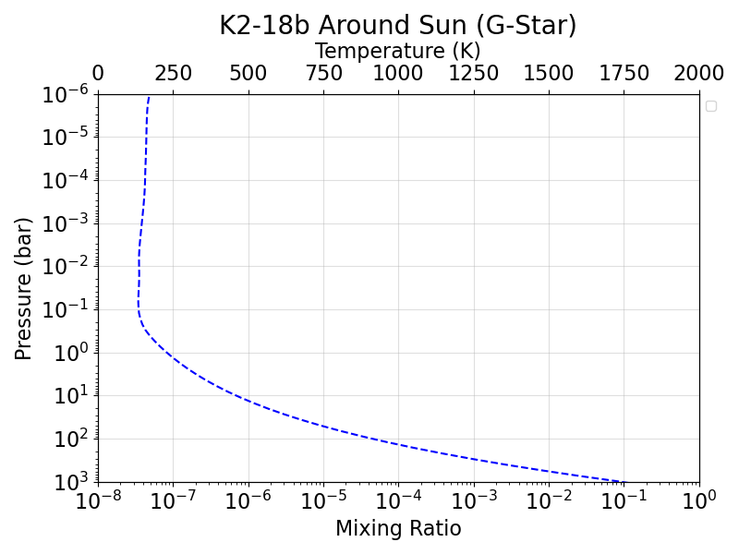
Workflow & Assumptions:
Key Observations on
Mini-Neptunes
Deep Atmospheres (>= 10x greater than Earth)
PT Profile Calculated from PICASO
Notes:
Step after 4 where I had some standard example where on one side there is composition and temperature (hydrogen rich, water & methane, deep atmospheres, show reflected light spectra (big methane features & water features for mini-Neptune, this is just one but we are interested in the wide possibility), then jump into grid assumptions.
Y-axis (10-2 bar, 10-3 bar and goes deeper)

Slide 7
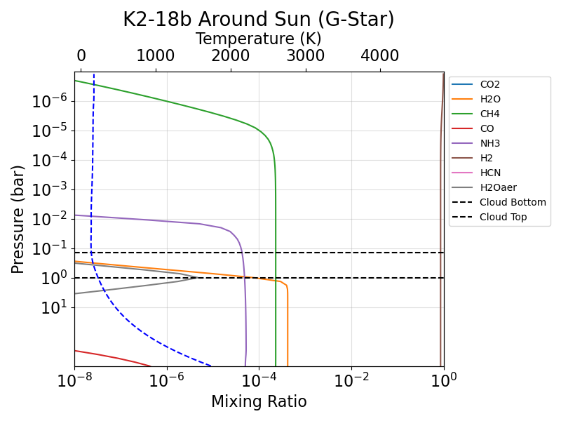
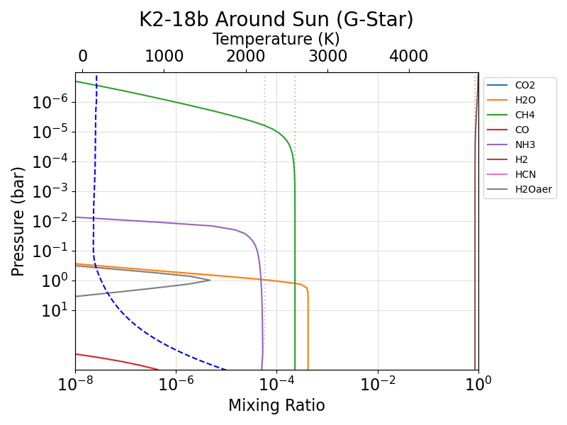
Workflow & Assumptions:
Key Observations on
Mini-Neptunes
Deep Atmospheres (>= 10x greater than Earth)
Hydrogen, Water, Methane and Ammonia Rich
Some have water condensation
Methane
Ammonia
Water Vapor Condensation
Liquid Water
Hydrogen
Notes:
Step after 4 where I had some standard example where on one side there is composition and temperature (hydrogen rich, water & methane, deep atmospheres, show reflected light spectra (big methane features & water features for mini-Neptune, this is just one but we are interested in the wide possibility), then jump into grid assumptions.

Slide 8
Workflow & Assumptions:
Key Observations on
Mini-Neptunes
Deep Atmospheres (>= 10x greater than Earth)
Hydrogen, Water, Methane and Ammonia Rich
Some have water condensation
With significant water condensation, we imposed an Earth-like grey cloud
Grey Cloud
Notes:
Step after 4 where I had some standard example where on one side there is composition and temperature (hydrogen rich, water & methane, deep atmospheres, show reflected light spectra (big methane features & water features for mini-Neptune, this is just one but we are interested in the wide possibility), then jump into grid assumptions.

Slide 9
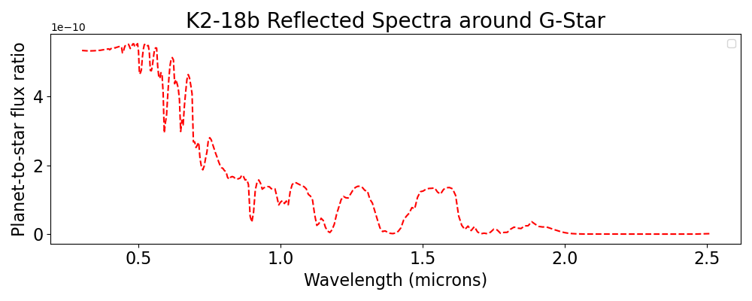
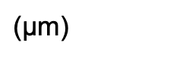
Workflow & Assumptions:
.65
H2O
CH4
.72
NH3
.6
.82
.94
1.12
1.0
1.4
1.7
.89
$\text{(}\text{μ}$m)
Notes:
Step after 4 where I had some standard example where on one side there is composition and temperature (hydrogen rich, water & methane, deep atmospheres, show reflected light spectra (big methane features & water features for mini-Neptune, this is just one but we are interested in the wide possibility), then jump into grid assumptions. In this reflected spectra, notate where water & methane show up.
Can’t just compare one model to an Earth-like planet and compare that (grid of calculation w/ many…); ammonia features (1.5, 1.9)

Slide 10
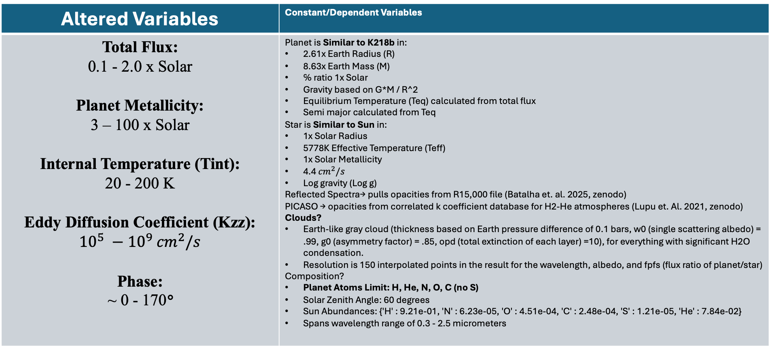
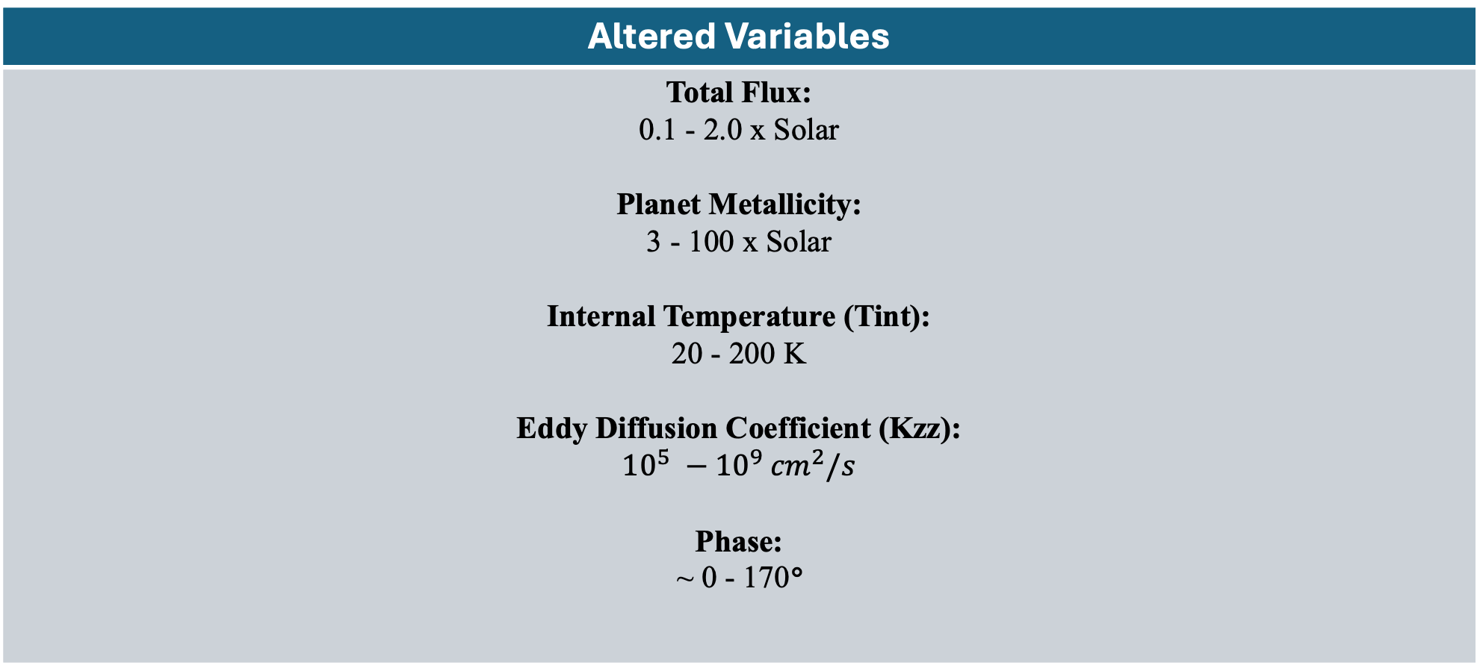
Workflow & Assumptions:
Step 4: ASSUMPTIONS
Altered Variables | Constant/Dependent Variables
Total Flux: 0.1 - 2.0 x Solar Planet Metallicity: 3 – 100 x Solar Internal Temperature (Tint): 20 - 200 K Eddy Diffusion Coefficient (Kzz): ${10}^{5} −{10}^{9} {cm}^{2}/s$ Phase: ~ 0 - 170° | Planet is Similar to K218b in: 2.61x Earth Radius (R) 8.63x Earth Mass (M) ℅ ratio 1x Solar Gravity based on G*M / R^2 Equilibrium Temperature (Teq) calculated from total flux Semi major calculated from Teq Star is Similar to Sun in: 1x Solar Radius 5778K Effective Temperature (Teff) 1x Solar Metallicity 4.4 ${cm}^{2}/s$ Log gravity (Log g) Reflected Spectra→ pulls opacities from R15,000 file (Batalha et. al. 2025, zenodo) PICASO → opacities from correlated k coefficient database for H2-He atmospheres (Lupu et. Al. 2021, zenodo) Clouds? Earth-like gray cloud (thickness based on Earth pressure difference of 0.1 bars, w0 (single scattering albedo) = .99, g0 (asymmetry factor) = .85, opd (total extinction of each layer) =10), for everything with significant H2O condensation. Resolution is 150 interpolated points in the result for the wavelength, albedo, and fpfs (flux ratio of planet/star) Composition? Planet Atoms Limit: H, He, N, O, C (no S) Solar Zenith Angle: 60 degrees Sun Abundances: {'H' : 9.21e-01, 'N' : 6.23e-05, 'O' : 4.51e-04, 'C' : 2.48e-04, 'S' : 1.21e-05, 'He' : 7.84e-02} Spans wavelength range of 0.3 - 2.5 micrometers
Altered Variables
Total Flux: 0.1 - 2.0 x Solar Planet Metallicity: 3 - 100 x Solar Internal Temperature (Tint): 20 - 200 K Eddy Diffusion Coefficient (Kzz): $${10}^{5} −{10}^{9} {cm}^{2}/s$$ Phase: ~ 0 - 170°
Notes:
Could mention some specific examples of constant/dependent variables (also all orbit the Sun, not K & F stars), also we only include a single water cloud roughly parameterized. Important information make it the whole slide.

Slide 11
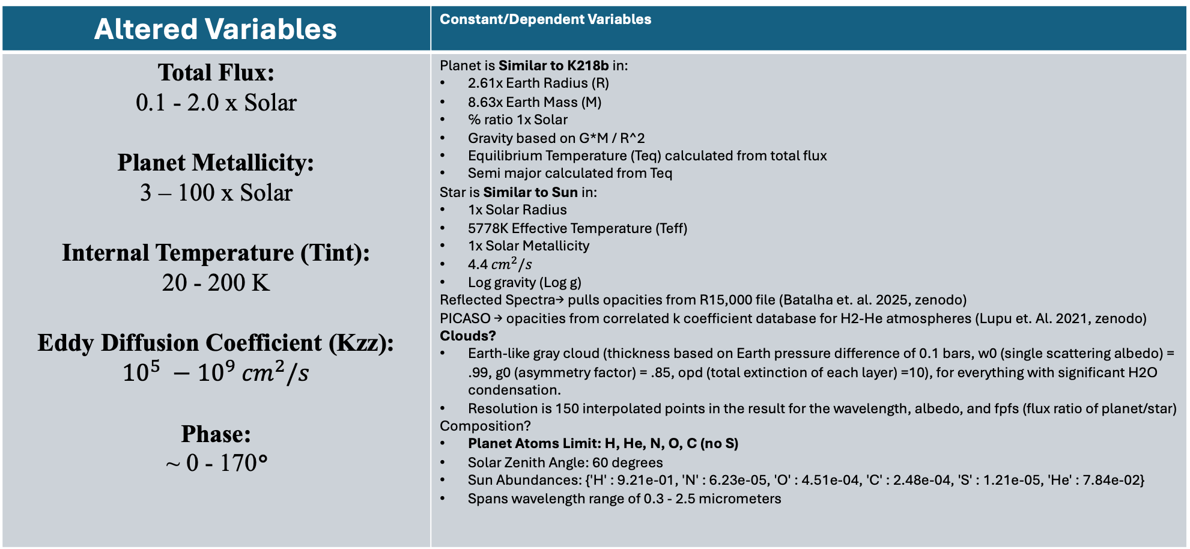
Workflow & Assumptions:
Step 4: ASSUMPTIONS
Altered Variables | Constant/Dependent Variables
Total Flux: 0.1 - 2.0 x Solar Planet Metallicity: 3 – 100 x Solar Internal Temperature (Tint): 20 - 200 K Eddy Diffusion Coefficient (Kzz): ${10}^{5} −{10}^{9} {cm}^{2}/s$ Phase: ~ 0 - 170° | Planet is Similar to K218b in: 2.61x Earth Radius (R) 8.63x Earth Mass (M) ℅ ratio 1x Solar Gravity based on G*M / R^2 Equilibrium Temperature (Teq) calculated from total flux Semi major calculated from Teq Star is Similar to Sun in: 1x Solar Radius 5778K Effective Temperature (Teff) 1x Solar Metallicity 4.4 ${cm}^{2}/s$ Log gravity (Log g) Reflected Spectra→ pulls opacities from R15,000 file (Batalha et. al. 2025, zenodo) PICASO → opacities from correlated k coefficient database for H2-He atmospheres (Lupu et. Al. 2021, zenodo) Clouds? Earth-like gray cloud (thickness based on Earth pressure difference of 0.1 bars, w0 (single scattering albedo) = .99, g0 (asymmetry factor) = .85, opd (total extinction of each layer) =10), for everything with significant H2O condensation. Resolution is 150 interpolated points in the result for the wavelength, albedo, and fpfs (flux ratio of planet/star) Composition? Planet Atoms Limit: H, He, N, O, C (no S) Solar Zenith Angle: 60 degrees Sun Abundances: {'H' : 9.21e-01, 'N' : 6.23e-05, 'O' : 4.51e-04, 'C' : 2.48e-04, 'S' : 1.21e-05, 'He' : 7.84e-02} Spans wavelength range of 0.3 - 2.5 micrometers
Notes:
Could mention some specific examples of constant/dependent variables (also all orbit the Sun, not K & F stars), also we only include a single water cloud roughly parameterized. Important information make it the whole slide.

Slide 12
Workflow & Assumptions:
Step 5: Use Reflected Light Spectra from PICASO to calculate Modern vs. Archean Earth.
Altered Variables | Constant/Dependent Variables
Modern Composition: N2 (0.79), O2 (0.21), O3 (7e-7), H2O (3e-3), CO2 (300e-6), CH4 (1.7e-6) Archean Composition: N2 (0.945), CO2 (0.05), CO (0.0005), CH4 (0.005), H2O (0.003) | Earth: Phase angle of 0 radians & degrees Earth radius & mass Same Sun parameters used in grids Includes a grey Earth cloud (from 0.6 to 0.7 pressure, same w0, g0, opd as the one used in Mini Neptunes grid)
Notes:
The thing at the bottom needs to be its own slide and step through it one-by-one. Circle archean and cross out modern b/c more similarity and focus on more interesting calc and modern earth ones as backup slides. PICASO is missing opacities relative to modern Earth. Just 3 & 4, backup slides. Take all mini-Nep in hab zone and look closest to archean earth, similar at longer wavelengths b/c similar methane and archean has reileigh scattering and hydrogen looks much brighter. But with LUVOIR not a whole spectrum at once, we have one photometric bin. Compare point to spectra in a range. Phase 1 of LUVOIR will we be tricked? Single data point that detects planet vs. single point detects water.
Modern vs. Archean (most similar between modern & archean).

Slide 13
Workflow & Assumptions:
Step 6:
We found the optimal* mini-Neptune whose reflected spectra…
…Most closely matched Archean Earth
…Total Flux was within the Habitable Zone (0.95-1.69 AU)
*The grids have linear interpolation capability between the range they were initially created with. We did so to find the optimized (minimized) planet to star fluxes that matched Modern and Archean Earth by utilizing a vector norm of the difference between each planet/star flux for a range of input combinations.
Notes:
The thing at the bottom needs to be its own slide and step through it one-by-one. Circle archean and cross out modern b/c more similarity and focus on more interesting calc and modern earth ones as backup slides. PICASO is missing opacities relative to modern Earth. Just 3 & 4, backup slides. Take all mini-Nep in hab zone and look closest to archean earth, similar at longer wavelengths b/c similar methane and archean has reileigh scattering and hydrogen looks much brighter. But with LUVOIR not a whole spectrum at once, we have one photometric bin. Compare point to spectra in a range. Phase 1 of LUVOIR will we be tricked? Single data point that detects planet vs. single point detects water.
Couple ways of comparing mini-Neptunes to archean (Comparison 1: full wavelength, full grid, Comparison 2: …, animation); may not be necessary (we compared subset of mini-Neptune grid planets in habitable zone and found spectrums most similar and just read it).

Slide 14
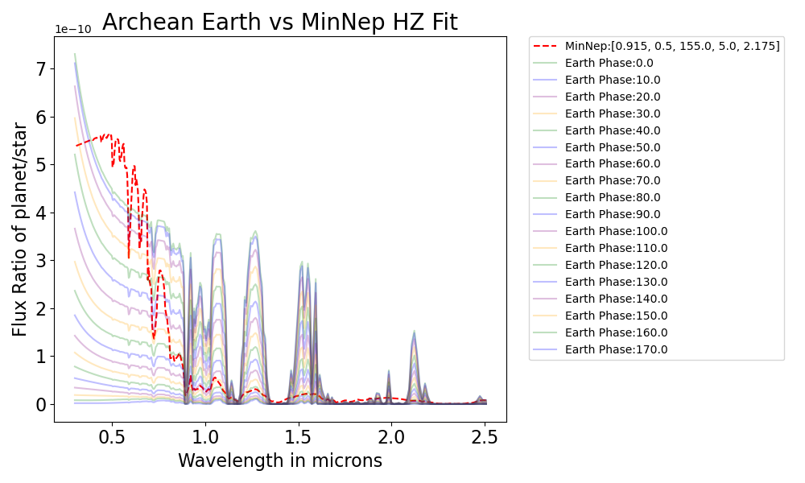
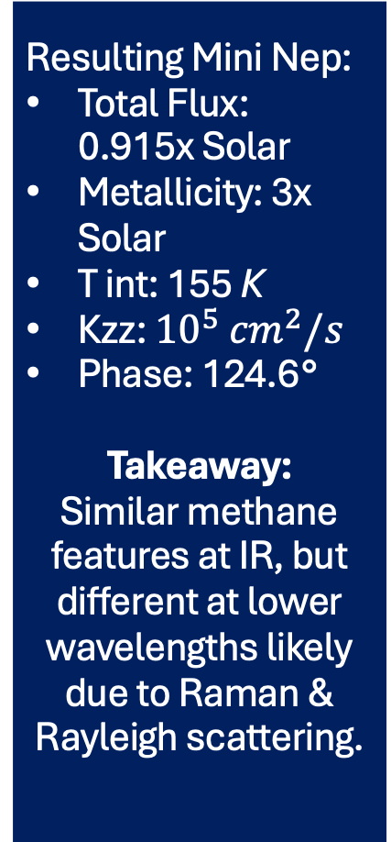
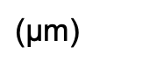
All Mini Neptune Values Total Flux in LUVOIR HZ, Archean Earth
Resulting Mini Nep:
Total Flux: 0.915x Solar
Metallicity: 3x Solar
T int: 155 K
Kzz: ${10}^{5}$ ${cm}^{2}/s$
Phase: 124.6°
Takeaway:
Similar methane features at IR, but different at lower wavelengths likely due to Raman & Rayleigh scattering.
CH4
CH4
Rayleigh + Raman
Scattering
H2O
CH4
H2O
CH4
H2O
H2O
CH4
CH4
H2O
Rayleigh Scattering
$\text{(}\text{μ}$m)
Notes:
Big axes for titles/numbers. Throughout plots, label features in the spectra based on Josh like Archean and Nick’s slides. Compared entire grid of mini-Neptune (one that matched Archean earth from .3-2 microns, similar b/c methane feature in IR (longer than 1micron, and can point at them), they look different at short wavelengths (N2 reileigh scattering on Earth, mini-Neptune is raman scattering mixed with reigleigh with a different shape by .5 microns). Easy to distinguish mini-Neptune from Archean Earth if you have entire spectrum, but not with Habitable worlds.
Sweet time explaining plot, colored lines are Archean Earth at different phases (0 degree is brightest, 170 is dimmest), compared to one mini-Neptune that fit well where I pick out methane features at IR and differences at short wavelengths. Question was whether we could make it look the same.
Add methane features (x2)

Slide 15
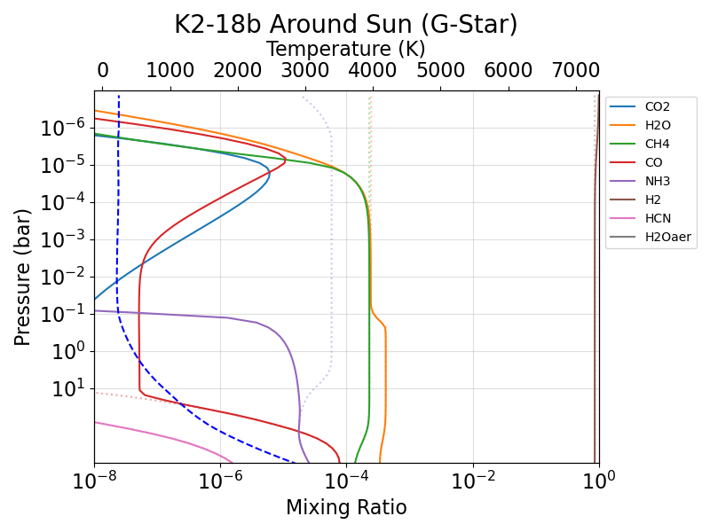
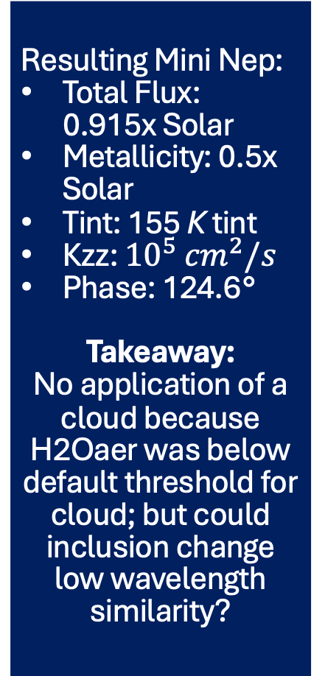
All MiniNep Values Total Flux in LUVOIR HZ, Archean Earth
Resulting Mini Nep:
Total Flux: 0.915x Solar
Metallicity: 0.5x Solar
Tint: 155 K tint
Kzz: ${10}^{5}$ ${cm}^{2}/s$
Phase: 124.6°
Takeaway:
No application of a cloud because H2Oaer was below default threshold for cloud; but could inclusion change low wavelength similarity?
Water Vapor Condensation…
…but no cloud!
Notes:
Big axes for titles/numbers. Throughout plots, label features in the spectra based on Josh like Archean and Nick’s slides. Compared entire grid of mini-Neptune (one that matched Archean earth from .3-2 microns, similar b/c methane feature in IR (longer than 1micron, and can point at them), they look different at short wavelengths (N2 reileigh scattering on Earth, mini-Neptune is raman scattering mixed with reigleigh with a different shape by .5 microns). Easy to distinguish mini-Neptune from Archean Earth if you have entire spectrum, but not with Habitable worlds.
Sweet time explaining plot, colored lines are Archean Earth at different phases (0 degree is brightest, 170 is dimmest), compared to one mini-Neptune that fit well where I pick out methane features at IR and differences at short wavelengths. Question was whether we could make it look the same.

Slide 16
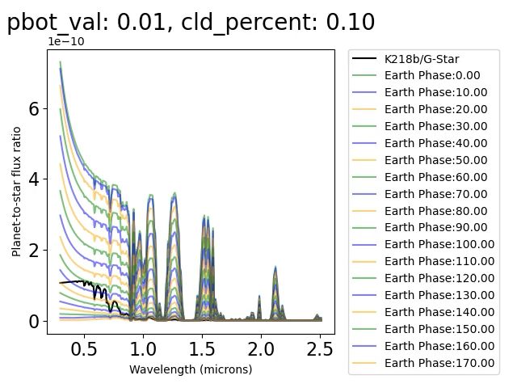
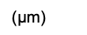
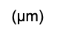
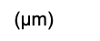
What if we imposed a cloud?
Bottom Pressure (log10 bars)
Clear Sky Fraction:
Bottom Pressure
(log10 bars):
Clear Sky Fraction:
$\text{(}\text{μ}$m)
$\text{(}\text{μ}$m)
$\text{(}\text{μ}$m)
Larger clear sky percentage, less cloudiness, larger flux ratio.
Larger pressure at the bottom w/ same thickness doesn’t change the spectra very much.
The Raleigh and Raman scattering are still distinguishable, more so for larger pressure at the bottom and clear sky fractions with the full spectrum.
Notes:
Big axes for titles/numbers. Throughout plots, label features in the spectra based on Josh like Archean and Nick’s slides, changing cloud properties where each animations changes bottom of cloud and percentage of the cloud. Conclusion: even when fittling with cloud parameters the reileigh scattering looks different from raman and seem possible to distinguish with the full spectrum.
Note cloud percentage is the amount multiplied by cloud free, so smaller value means there is more cloud! What is pressure bottom units in, as clear sky fraction (cld_percent), pbot (log of dynes/cm^2, but find the units). So they are in units of 10^p_bot so 10^0.01 ~ 1 bar.

Slide 17
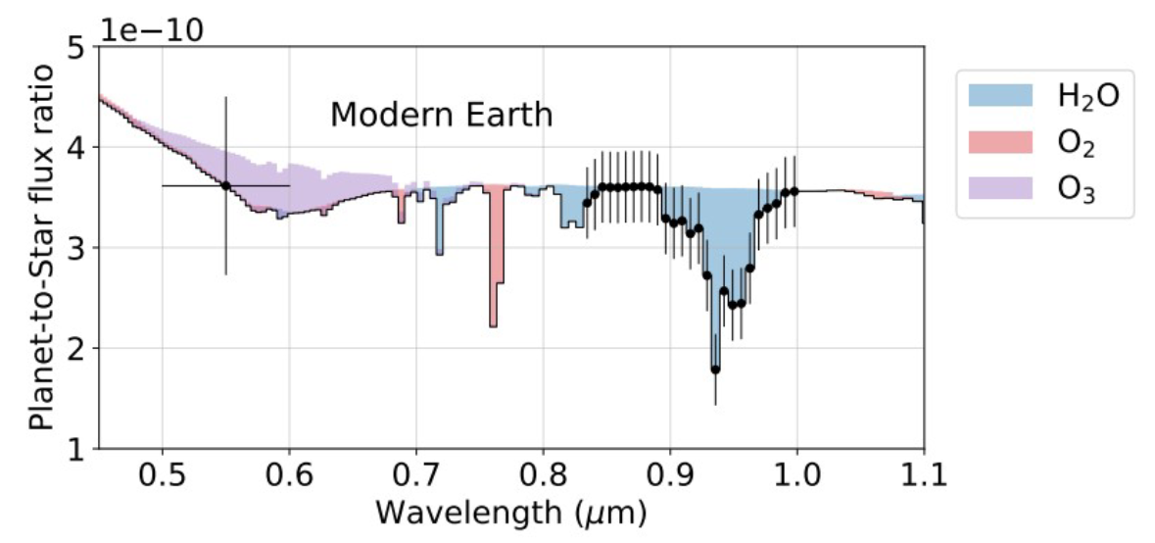
LUVOIR Mission: Search for Exo-Earths
Phase 1:
Detect potential Exo-Earths:
Detect a planet in the habitable zone using multi-color point-source photometry
Constrain orbits
Search for water vapor absorption in the planet’s atmosphere at 0.94 microns.
H2O Absorption Feature at 0.94 microns
Initial Single Point Detection (5.5 microns)
Phase 2:
Characterize Exo-Earth candidates via stars activity, planet mass, biosignatures, spectrum, and complete orbit.
For HWO we won’t have the full spectra of our exoplanet candidates, how does this effect the ability to distinguish Mini-Neptunes from Terrestrial Earths?
Notes:
Big axes for titles/numbers. Throughout plots, label features in the spectra based on Josh like Archean and Nick’s slides.
Previous comparison had full spectrum, but we don’t get the full spectrum (chunks at a time, photometric at .55, and water signature, will mini Neptune look different?

Slide 18
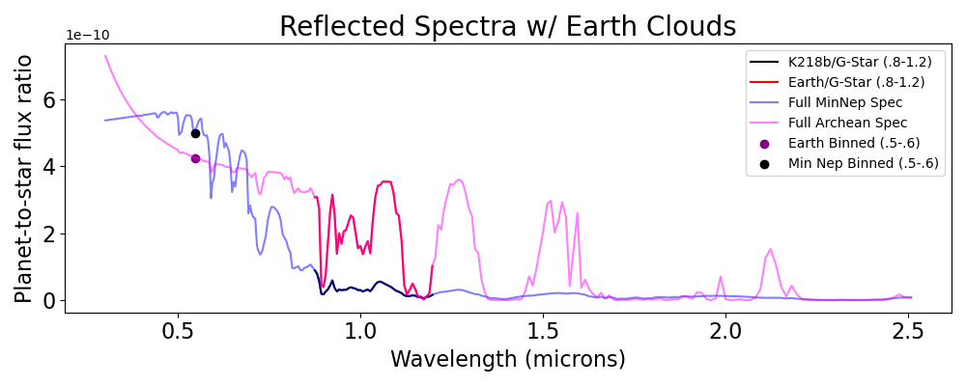
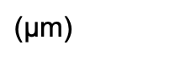
Comparing a single point to a wavelength bin:
Single-Point Photometry
H2O Absorption at 0.94 microns
$\text{(}\text{μ}$m)
Earth is at full phase and compared to the optimized mini-Neptune in the habitable zone range of total fluxes.
The single-point photometry could be difficult to distinguish with different clouds, but at longer wavelengths, Earth has dimmer flux ratios than the mini-Neptune.
Notes:
Conclusions → yeah look different (greyed out band), can match in brightness in photometry but will be much dimmer at .9 microns.

Slide 19
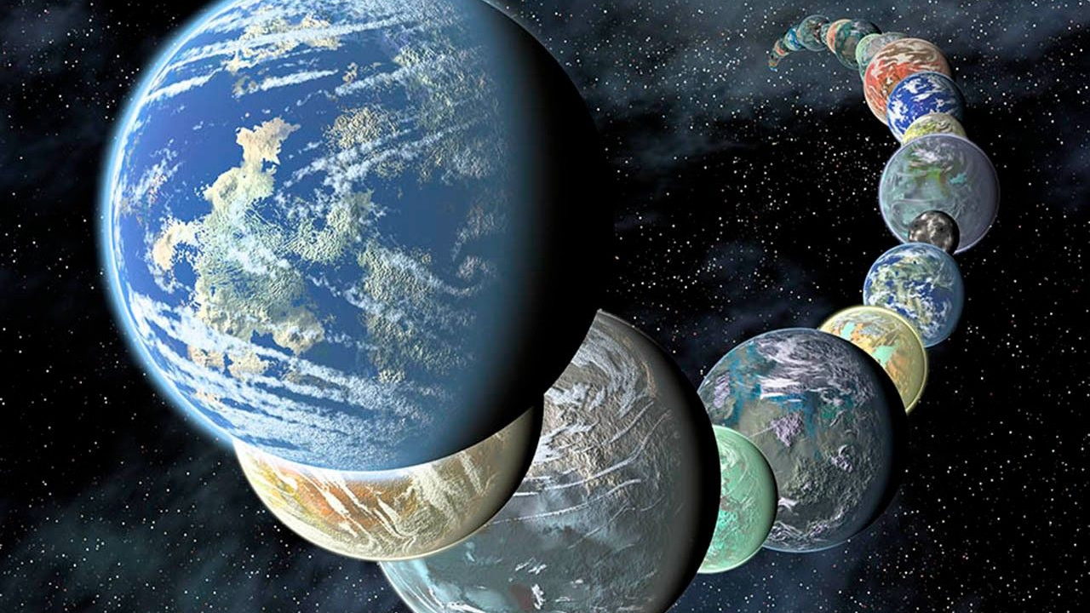
Conclusions:
We created a grid of K218b-like mini-Neptunes around a Sun-like star with varying flux, metallicity, internal temperature, phase, and heat flux across 0.3 – 2.5 microns, and found the closest spectra in the HZ to Archean Earth.
In near-IR, mini-Neptunes can look like Archean Earth due to similar methane and water absorption features, but in shorter wavelengths the spectrum were easier to distinguish due to differences in Raman and Rayleigh scattering.
Future Work:
Clouds had a significant effect on the observable spectra, so a more extensive exploration beyond Earth-like grey clouds, perhaps with different thicknesses, could change results.
Our mini-Neptune grid could have also varied more parameters (i.e. included Sulphur, changed C/O ratio, etc.) to provide a more extensive exploration.
With the initial data from HWO, single photometric point and snippet of the spectra, would mini-Neptunes and Archean Earth be noticeably different/distinguishable?
Does this affect required wavelength binning (resolution) and precision necessary for HWO?
Image Credit: NASA/JPL-Caltech/R. Hurt
Notes:
What we did; tricked that thinking mini-Neptunes would be fooled or not (tentative conclusion, prelim result → expect interuptions)
Repeat everything you did: we used models of mini Neptunes orbiting Sun like stars w/ reflected spectroscopy. Conclusions → in near-IR archean Earth-like can look like mini-Neptune but reileigh scattering at shorter are easier to distinguish regardless of cloud properties of the model. Even with small amount of data to first characterize, it might be do-able to distinguish.
Future Work/Caveats:
- Limited spectra (have done preliminary work but haven’t figured it out yet and would bump down to 15 min.)

Slide 20

Acknowledgements & References
I would like to thank my mentors Nick Wogan and Natasha Batalha, OSTEM advisors, and the greater HWO community for their support this summer!
Let’s Connect!
Mukherjee, et al. “PICASO 3.0: A One-Dimensional Climate Model for Giant Planets and Brown Dwarfs.” The Astrophysical Journal (2022): 157.
Wogan N. F., Batalha N. E., Zahnle K. J. et al. 2024 ApJL 963 L7 DOI 10.3847/2041-8213/ad2616
Image Credit: NASA/JPL-Caltech/R. Hurt
Notes:
What we did; tricked that thinking mini-Neptunes would be fooled or not (tentative conclusion, prelim result → expect interuptions)
Repeat everything you did: we used models of mini Neptunes orbiting Sun like stars w/ reflected spectroscopy. Conclusions → in near-IR archean Earth-like can look like mini-Neptune but reileigh scattering at shorter are easier to distinguish regardless of cloud properties of the model. Even with small amount of data to first characterize, it might be do-able to distinguish.
Future Work/Caveats:

Slide 21
Backup Slides
These include the optimization results (best fits) of other areas of optimization explored:
All Mini-Neptunes in the grid (no limitations) compared to Archean/Modern Earth.
Total fluxes being within 1x solar flux between Archean/Modern Earth and Mini-Neptunes.
Mini-Neptunes in the HZ as defined by LUVOIR but compared with Modern Earth.
Additional comparison between PICASO and Photochem (for those less aware of the software)
LUVOIR Single Point Photometry vs Snippit of Reflected Spectra (can we distinguish?) initial exploration
Image Credit: NASA/JPL-Caltech/R. Hurt
Notes:
What we did; tricked that thinking mini-Neptunes would be fooled or not (tentative conclusion, prelim result → expect interruptions); prelim results (used grey clouds but more complicated than that), more exhaustive spectra comparison), we tried to capture a wide variety of mini-Neptunes but there are more possibilities.

Slide 22
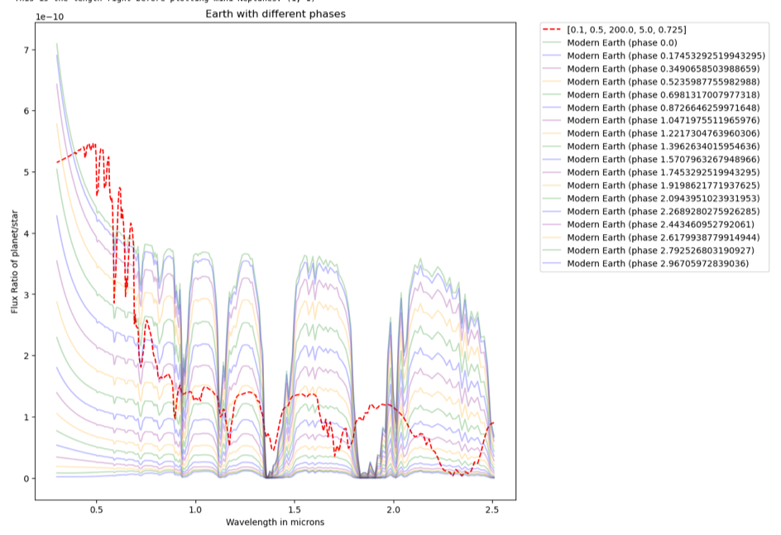
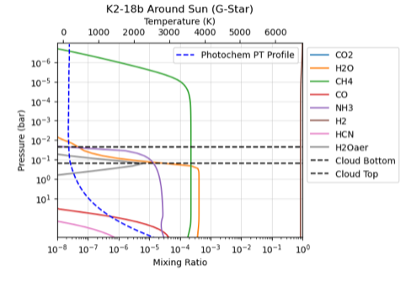
Results: All MiniNep Inputs, Modern Earth
Input: total flux = .1x solar, metallicity = .5x solar, tint = 200K, kzz = 10^5 cm/s^2, phase = 0.725 radians
Notes:
Giant methane features at 1.7 and 1.4 in mini-Neptune but not that much in modern atmosphere so no confusion.

Slide 23
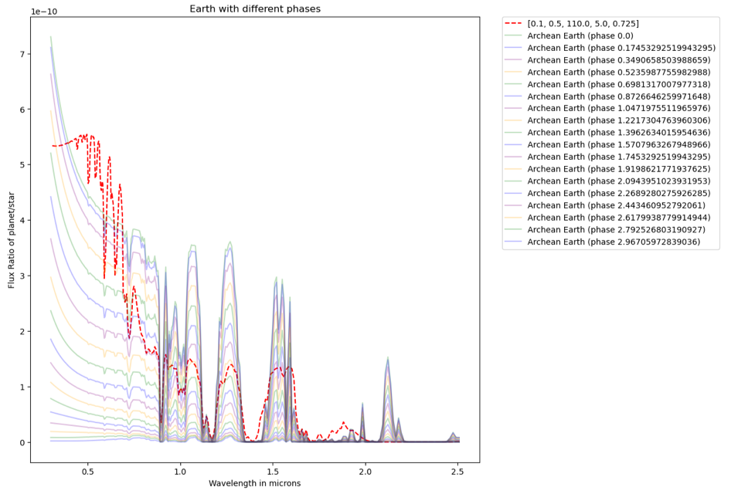
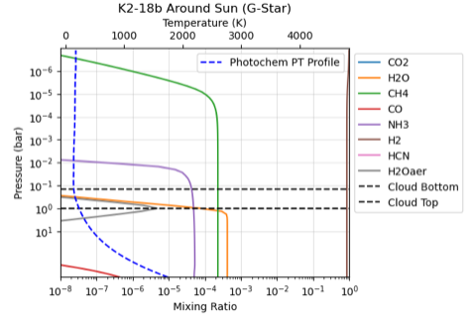
All MiniNep Inputs, Archean Earth
Input: total flux = .1x solar, metallicity = .5x solar, tint = 110K, kzz = 10^5 cm^2/s, phase = 0.725 radians
Notes:
Methane features are more similar, so there could be confusion.

Slide 24
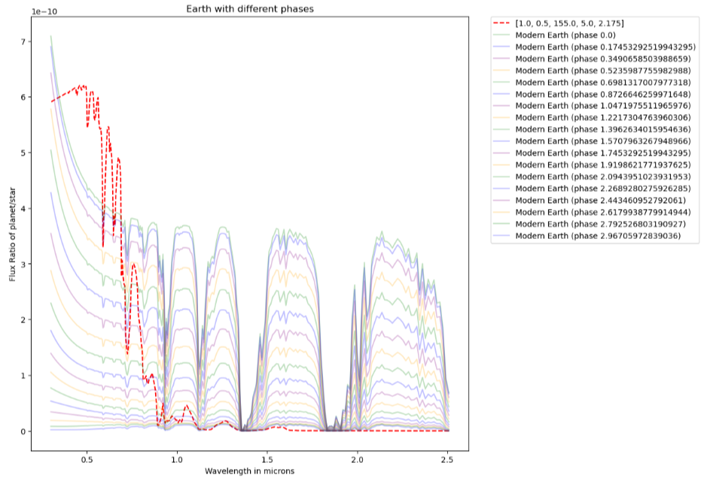
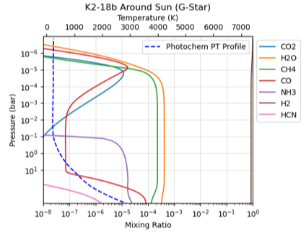
All MiniNep Inputs, Total Flux= 1x Solar, Modern Earth
Inputs: 1x solar, 0.5x metallicity, tint = 155K, kzz = 10^5 cm^2/s, phase = 2.175 radians
Notes:
Report all phases in degrees, all the water is absorbed by methane (why no water condensation and same distance from Earth, answer is methane is good at heating upper atmosphere so we cannot condense the water).

Slide 25
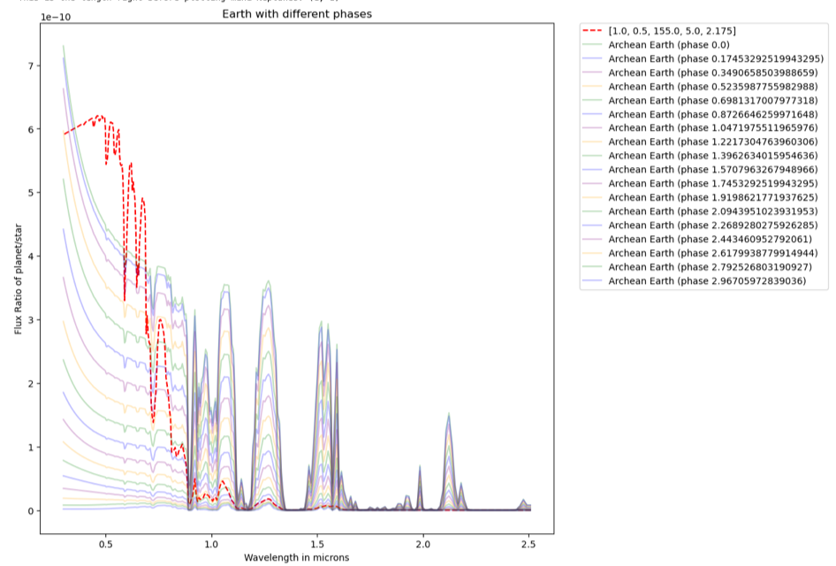
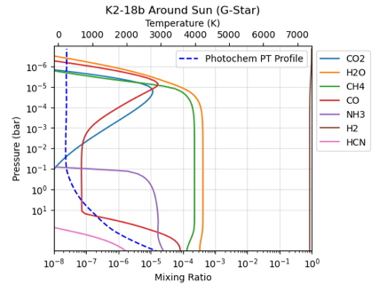
All MiniNep Inputs w/ Total Flux= 1x Solar, Archean Earth
Inputs: 1x solar total flux, 0.5x solar metallicity, 155K tint, kzz = 10^5 cm^2/s, phase = 2.175 radians
Notes:
Ask Natasha → why are mini neptunes so bright at .5 microns and always way different than Rayleigh slope. Just showing archean results.

Slide 26
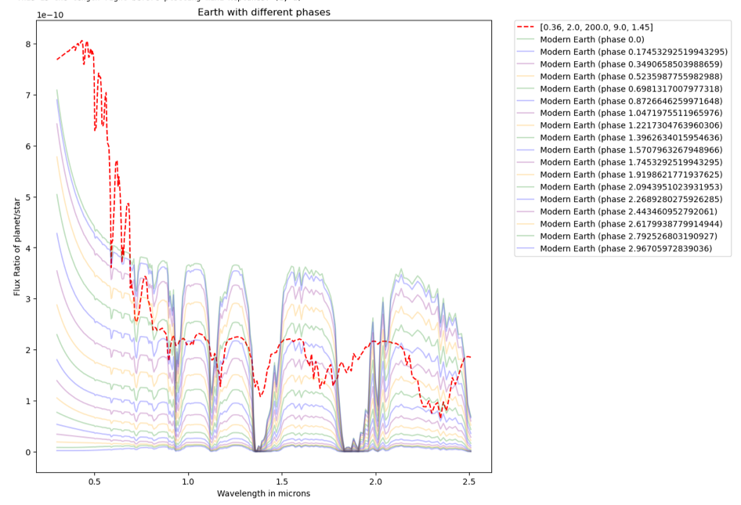
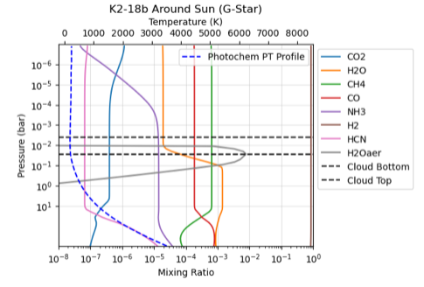
All MiniNep Values, Total Flux in LUVOIR HZ, Modern Earth
Inputs: 0.36x solar total flux, 2x solar metallicity, 200K tint, 10^9 cm^2/s kzz, 1.45 radians phase
Notes:
Solar flux habitable zone: .99 - 1.67 AU,

